Slide 1
How Does a Bike-Share Navigate Speedy Success?
A Case Study on Bike usage by subscribed and non-subscribed members
Author: Yannic Chen
Date: 12.05.2021

Slide 2
Introduction
SCENARIO:
Cyclistic ltd. is a bike sharing company with a fleet of 5824 bicycles and 692 stations across Chicago.
Their pricing plans are:
single-ride pass
full-day pass
annual membership
The short term goal of the company is to maximize profit by converting casual riders to annual members.
ASK:
Behavioural difference between casual riders and members
Why would casual riders buy a membership
How can digital media influence casual riders to become members

Slide 3
Scope of analysis
DATA
12 Month of Cyclistic trip Data
Availability from Motivate International Inc. (https://divvy-tripdata.s3.amazonaws.com/index.html)
Restrictions:
no personal information (i.e. customer id)
ROCCC
Reliability: the data are directly fetched from the bicycle
Original: the data comes from the primary source
Comprehensive: The data contains the start and end date/time/station. Also shows whether rider was a member or casual rider
Current: Data range from May 2020 to April 2021
Cited: the data comes from the primary source

Slide 4
Results

Slide 5
Ride Length between Member and Casual
 | Mean Ride Length | Median Ride Length
Casual | 35min 52s | 20min 49s
Member | 15min 26s | 11min 19s
Casual riders cycle for a longer duration than members

Slide 6
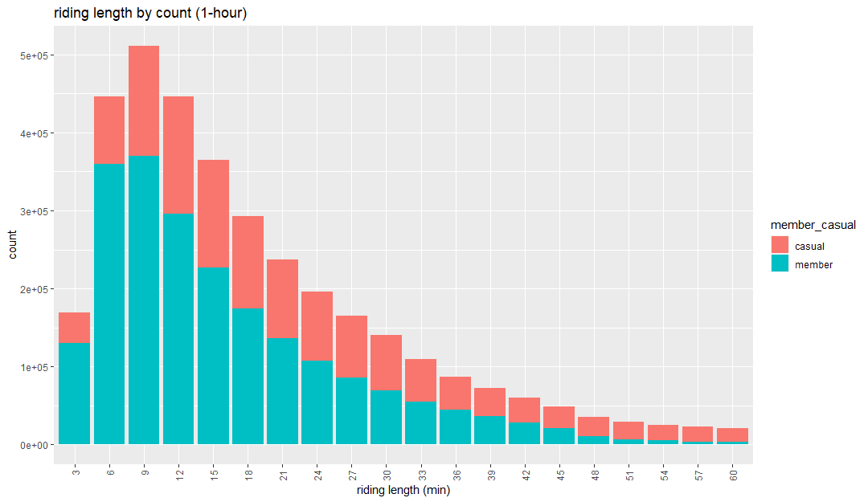
Ride length of casual and members
Members are most frequently using the bicycles for short durations.
This discrepancy starts to even out toward the 45 minute mark
Long duration (> 45 minutes) riders are mostly casual riders.

Slide 7
Observations
Casual riders ride for longer durations compared to members (break even at 45 minutes)

Slide 8
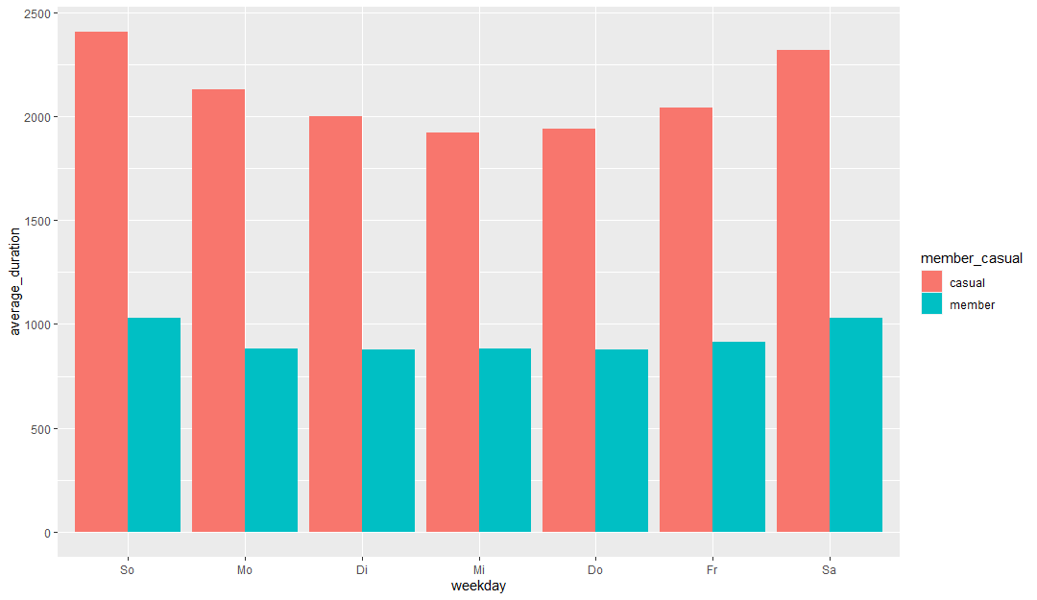
Ride Length on days of the week
Average duration of members are consistent throughout the week.
Casual riders cycle longer on the weekends (and days before/after the weekend).
Notes:
add tittle
change y-axis label
increase font size

Slide 9
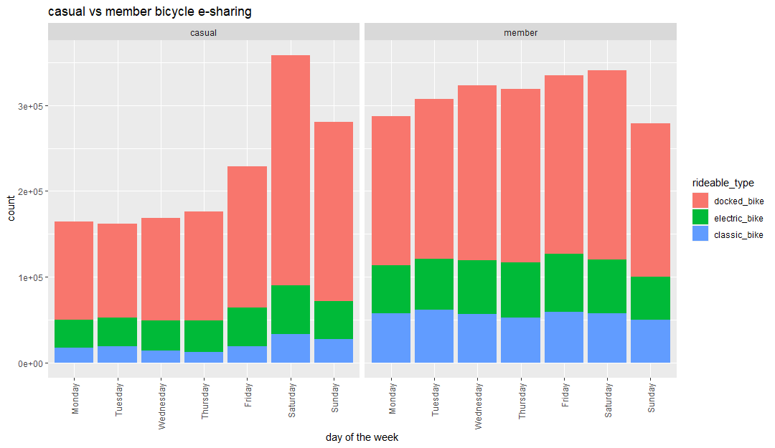
Riding frequency across the week
Casual riders use the bicycles most frequently on the weekends.
Members bike usage are consistent across the week, with a small reduction on sunday.
Bikes are more often used by members on all days, except saturday (sunday usage is very similar).
Docked bikes are by far the most popular.
Members use classic bikes more frequently than casual riders.
Notes:
increase font size

Slide 10
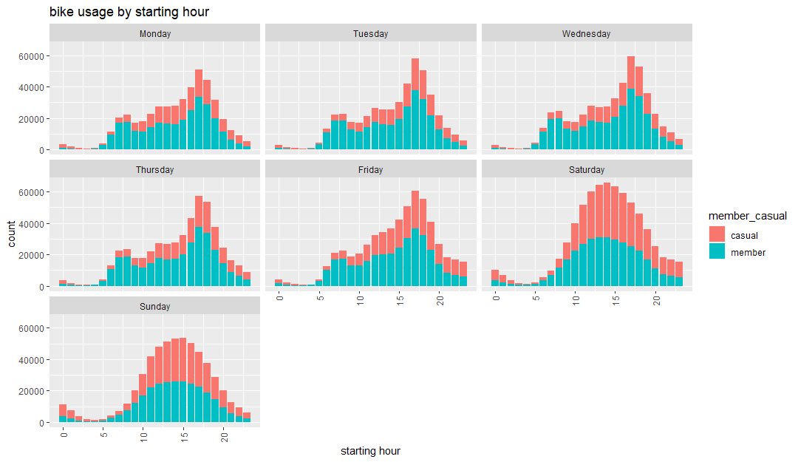
Bike usage by time of the day
On working days, there the amount of bike usage is bimodal (two peaks). These peaks are at 7-8am and 5pm.
On weekends the bike usage is more normally distributed.

Slide 11
Observations
Casual riders ride for longer durations compared to members (break even at 45 minutes)
Casual riders cycle mostly on the weekends, while members are consistent throughout the week
bicycle usage is bimodal on weekdays, peaking at 7-8am and 5pm.

Slide 12
Observations
Hypothesis
Casual riders ride for longer durations compared to members (break even at 45 minutes)
Casual riders cycle mostly on the weekends, while members are consistent throughout the week
bicycle usage is bimodal on weekdays, peaking at 7-8am and 5pm.
Casual riders cycle as a leisure activity, which therefore results in a longer riding duration compared to members.
Leisure activities are done in the free time, which for the majority of people is the weekend.
Members use bikes to get to and return from work. This is consistent with the standard start and end working hours

Slide 13
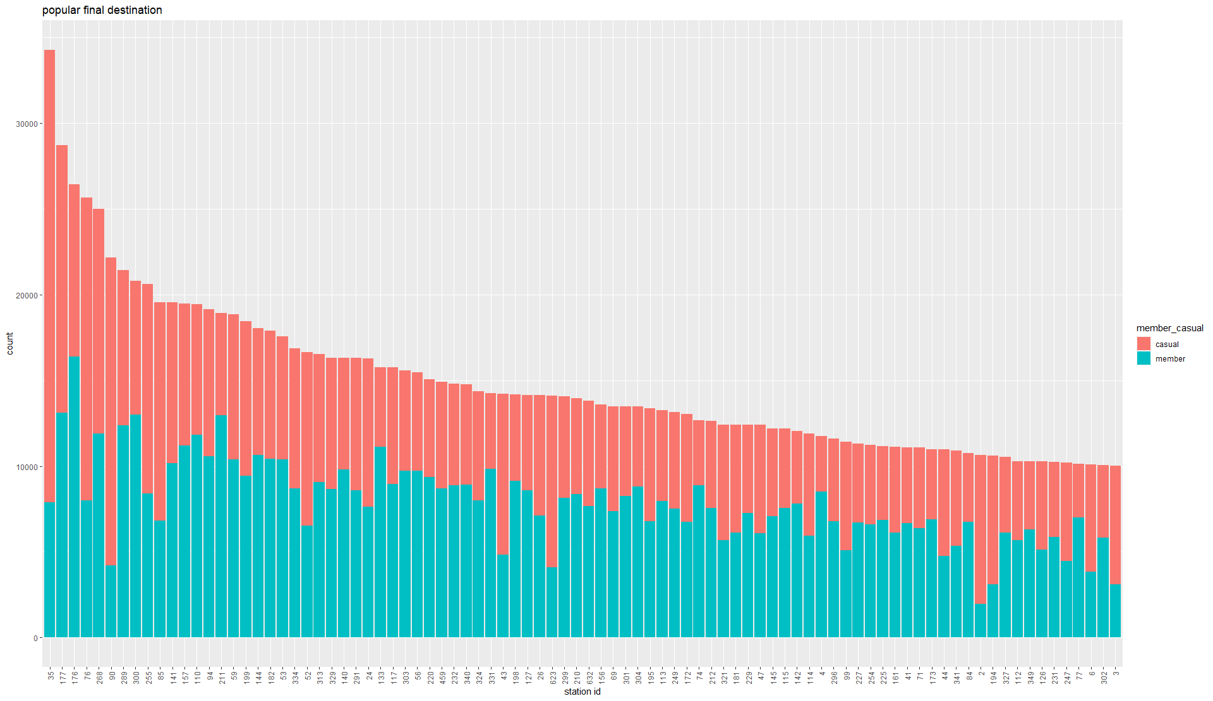
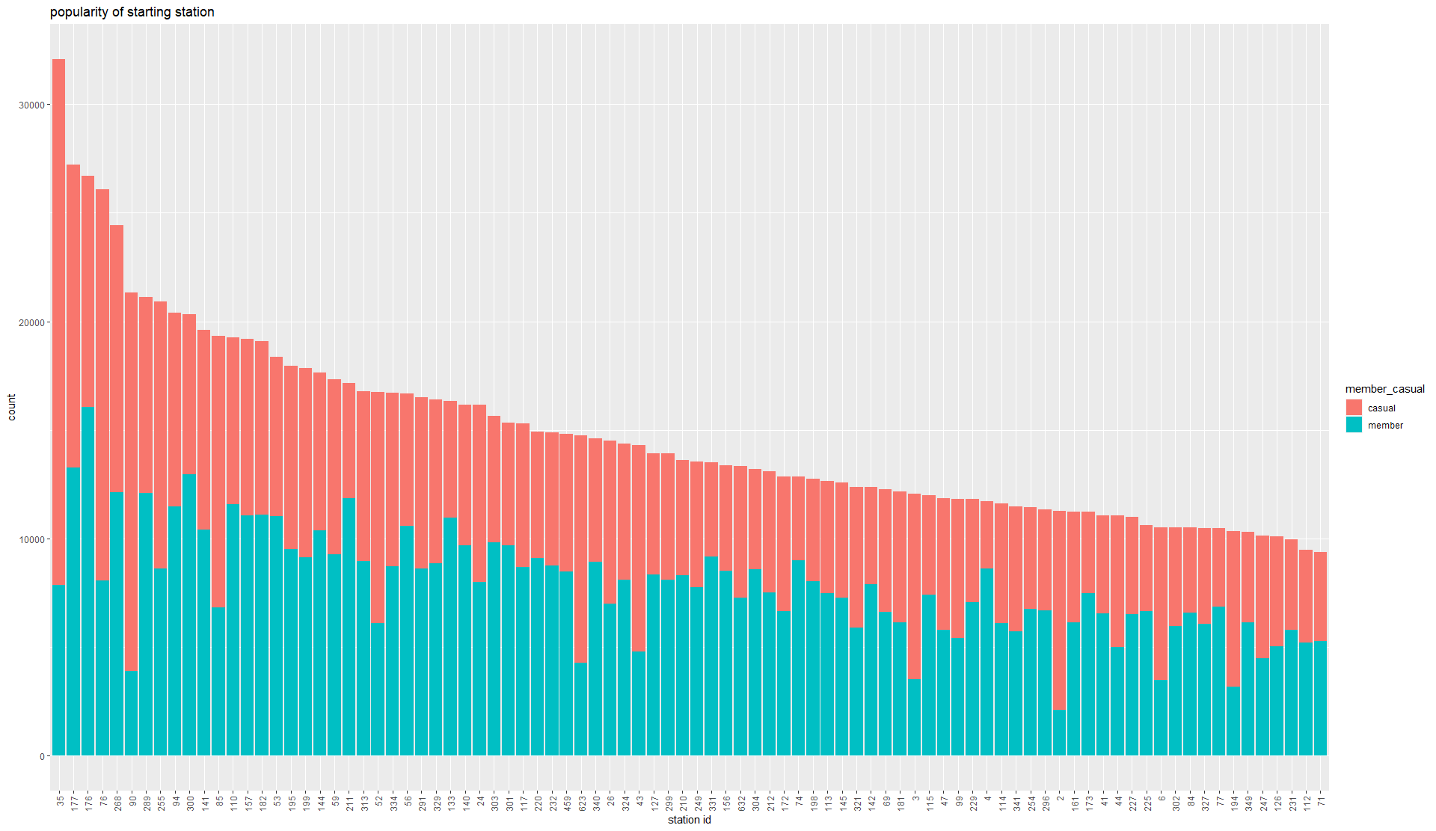
Popularity of stations to start and end a ride
Stations that are very popular among casual riders are often not frequented by members.
Usage of stations by members are less concentrated and more spread out.
Notes:
station 35 and 80 are popular start stations for casuals.

Slide 14
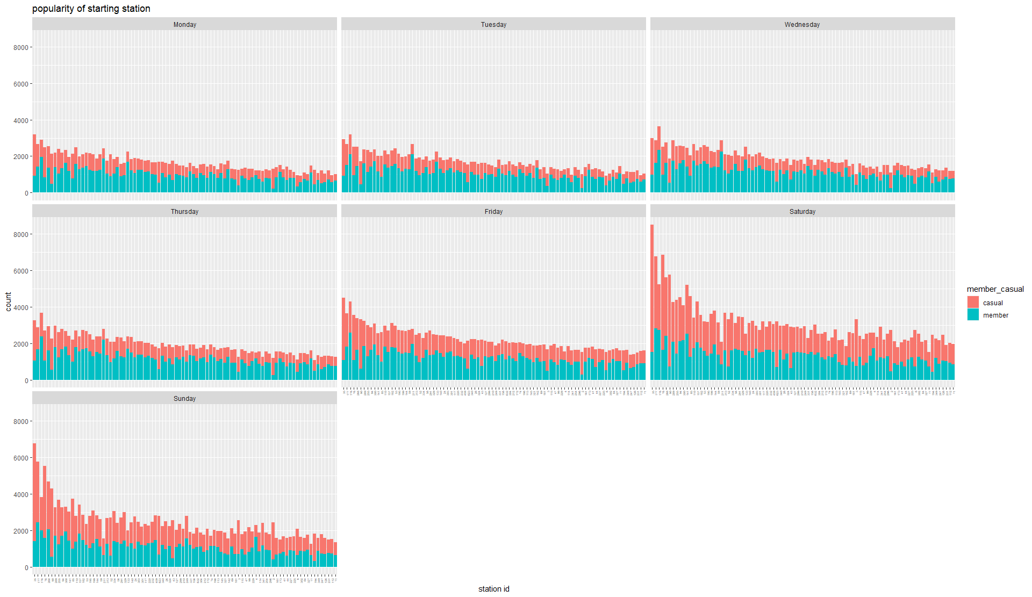
Popular start stations throughout the week
The amount of starting starting stations do not vary much among members.
There is a large spike of usage of popular starting station by casual riders on the weekend (same trend for ending stations (data not shown).

Slide 15
Observations
Hypothesis
Casual riders ride for longer durations compared to members (break even at 45 minutes)
Casual riders cycle mostly on the weekends, while members are consistent throughout the week
bicycle usage is bimodal on weekdays, peaking at 7-8am and 5pm.
Stations have vastly different popularity for casual riders.
popularity of stations for casual riders is often inversely proportional to the popularity for members.
Casual riders cycle as a leisure activity, which therefore results in a longer riding duration compared to members.
Leisure activities are done in the free time, which for the majority of people is the weekend.
Members use bikes to get to and return from work. This is consistent with the standard start and end working hours
Bike rides for leisure activity would often be located at “greeneries” (i.e. parks).
Members riding bikes to and from work are unlikely be located near “greeneries”, as these area are not population dense.
Notes:
Find out the most popular leisure start station.

Slide 16
How to turn casual cyclist to members
Make membership worthwhile for occasional leisure bicycle rides
Create increased incentive for using bicycle as a means of transport to and from work
Create motivation to cycle to work even when ride length is > 45 minutes

Slide 17
How to turn casual cyclist to members
Make membership worthwhile for occasional leisure bicycle rides
Create increased incentive for using bicycle as a means of transport to and from work
Create motivation to cycle to work even when ride length is > 45 minutes
Create a membership option that is cheaper but restricts usage of bikes to weekends only.
Or restricts the usage for only specific stations (popular for leisure rides).
Enhance popularity of leisure bicycle ridings. (through advertising “good” cycling routes)
Create events for to increase frequency of leisure rides.

Slide 18
How to turn casual cyclist to members
Make membership worthwhile for occasional leisure bicycle rides
Create increased incentive for using bicycle as a means of transport to and from work
Create motivation to cycle to work even when ride length is > 45 minutes
Advertise health benefits of daily cycling, instead of other means of transport.
Enhance user experience for cycling to and from work
Create health apps that tracks user “sport” activity. To incentivise bike usage.
Create reward system that rewards cycling frequency and length

